Slide 1

Lecture 4 Abstract

Slide 2
Contents
Section A IMRC Format
Section B Linguistic Features
Section C Formal Language
Section E Exercise

Slide 3

Section A
IMRC Format
1. What should be contained in an abstract, and why? Is it a good idea that we write only results, discussion and final conclusions in the abstract due to the word number limit, and because emphasizing our achievements is more important than methods?

Slide 4
Abstract
An abstract, as its name suggests, should contain the main points of all the IMRC to display the complete content of a paper.
Before a read, especially a busy reader, decides to further read the paper, he/she first has to evaluate the paper from its abstract and the title.
An abstract, therefore, plays an effective role to provide the reader with a logical and valid miniature of the whole research.
The aim must be explicit.
The methods have to show the reliability of the research. If the method has been commonly convinced in the research field, the term of it should be briefly notified.
Results and conclusions are definitely the central components.

Slide 5
Section A
IMRC Format
2. What is a proper length of an abstract in a journal? Tick the correct statements about the normal requirement of the length.
It is required by a specific journal.
It is decided by a particular discipline.
It depends on the total number of words of the paper.
Generally, the length should be 5% of the total paper.
It is normally about 300 English words.
The writer decides the length according to his/her needs.
It should normally contain no less than 250 content words.

Slide 6
Section A
IMRC Format
3. How many key words can we list with the abstract? And what are the rules?
Tick the following phrases that you think are correct.
List 3-5 key words to follow the universally normal regulation.
Show 7-10 words to indicate the research comprehensively.
Pick up key words from title because it covers the most import ant points.
Decide the words that are typically significant for paper retrieval and index.
Select words from the abstract because it represents the paper.
Use the words that indicate the core of the research and are most frequently written.
Choose the words in Introduction because it conveys the research direction.
Keep consistent English and Chinese key words in the same paper.
Consult National Chinese Thesaurus for Chinese key words.
Determine the key words after the paper is finally finished.

Slide 7
Section A
IMRC Format
4. An abstract is structured in an IMRC format (Generally, in an abstract “Conclusion” refers to both Discussion and Conclusion). Because of a different length, an abstract shows the format with a diversified way. Read the short abstract (66 words) and divide the text into I (Introduction), M (Methods and Materials), R (Results), and C (Conclusion). Then discuss: What is the way the format is organized?

Slide 8
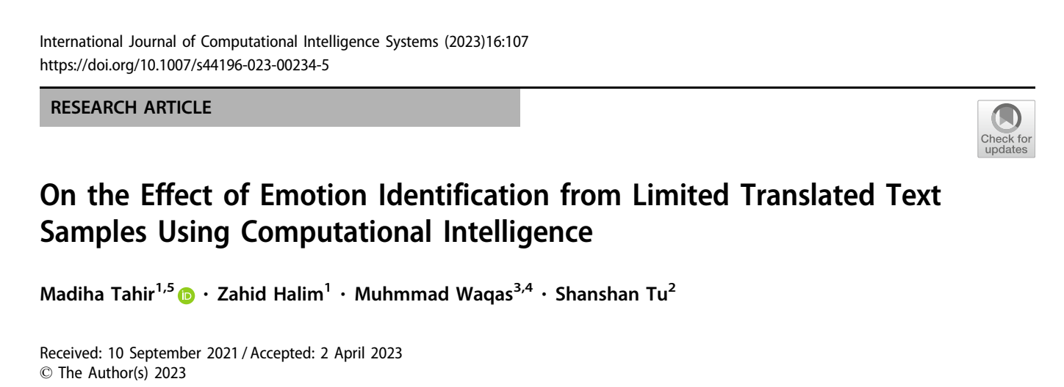
Section A
IMRC Format
6. Have a quick glance at the longer abstract (266 words), and identify the four sections, marking I, M, R, and C in square brackets [ ] after each section.
Notes:
2班2组

Slide 9

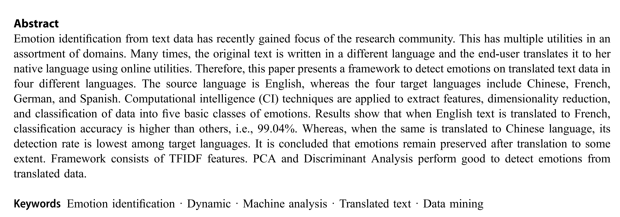
Notes:
2班2组

Slide 10
Abstract: Emotion identification from text data has recently gained focus of the research community. This has multiple utilities in an assortment of domains. Many times, the original text is written in a different language and the end-user translates it to her native language using online utilities. Therefore, this paper presents a framework to detect emotions on translated text data in four different languages. The source language is English, whereas the four target languages include Chinese, French, German, and Spanish. Computational intelligence (CI) techniques are applied to extract features, dimensionality reduction, and classification of data into five basic classes of emotions. Results show that when English text is translated to French, classification accuracy is higher than others, i.e., 99.04%. Whereas, when the same is translated to Chinese language, its detection rate is lowest among target languages. It is concluded that emotions remain preserved after translation to some extent. Framework consists of TFIDF features. PCA and Discriminant Analysis perform good to detect emotions from translated data.

Slide 11
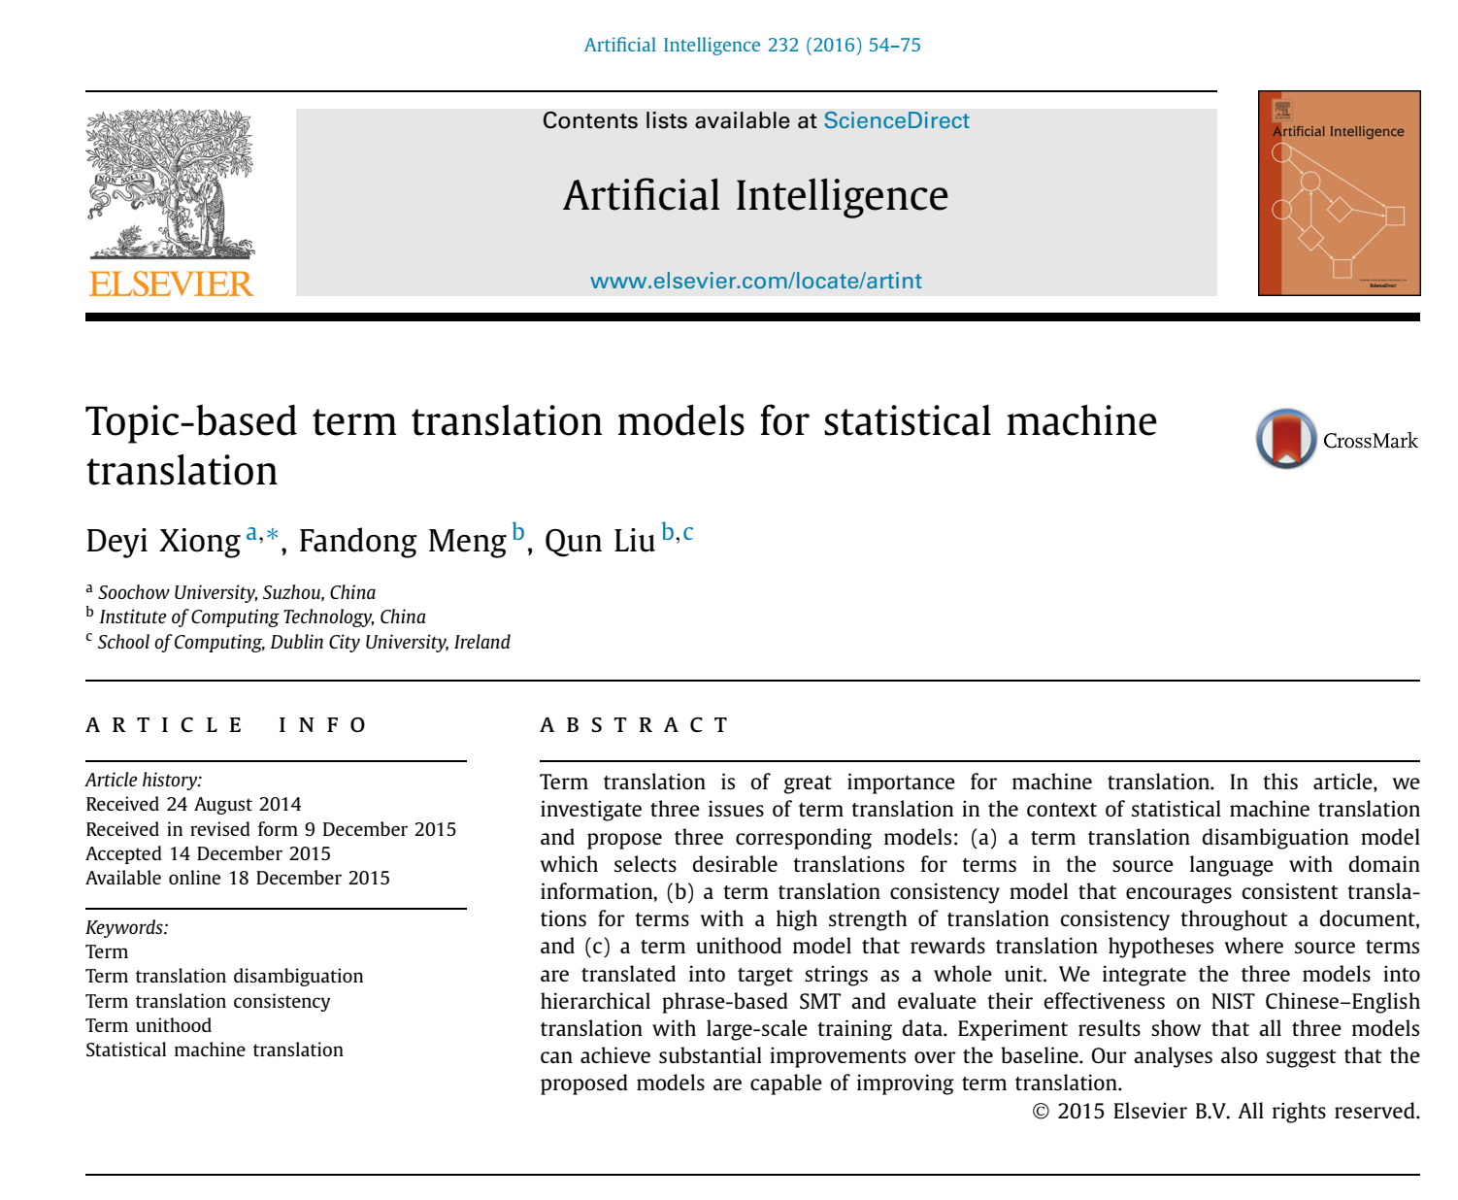
Notes:
2班2组

Slide 12
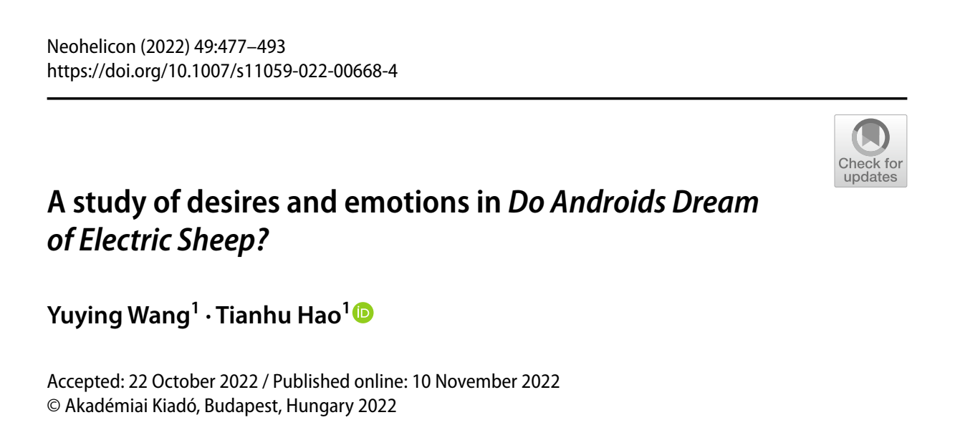
Notes:
1班8组

Slide 13
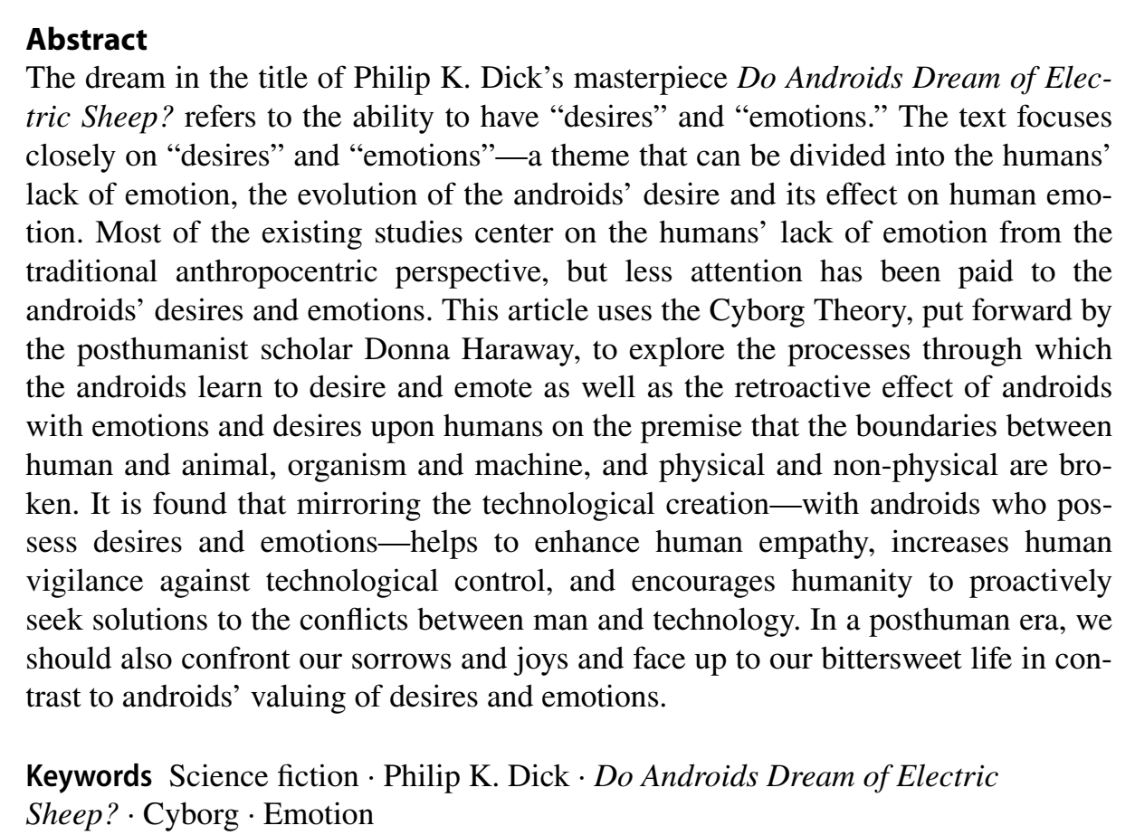
Notes:
1班8组

Slide 14

Notes:
1班6组

Slide 15
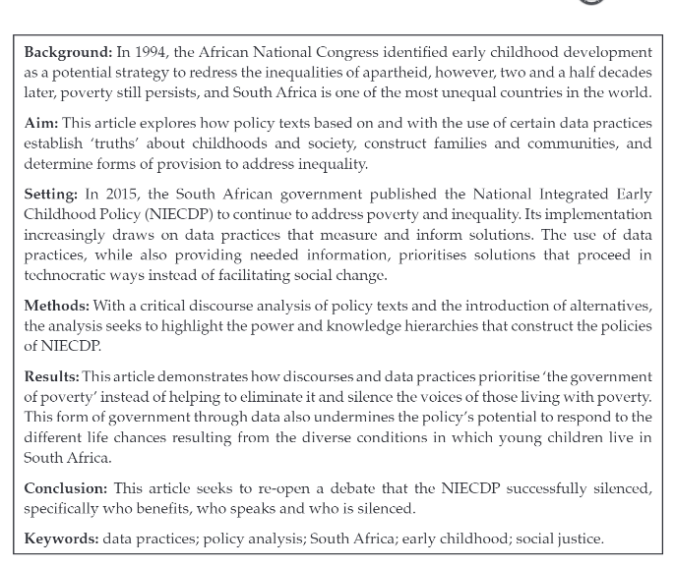

Slide 16
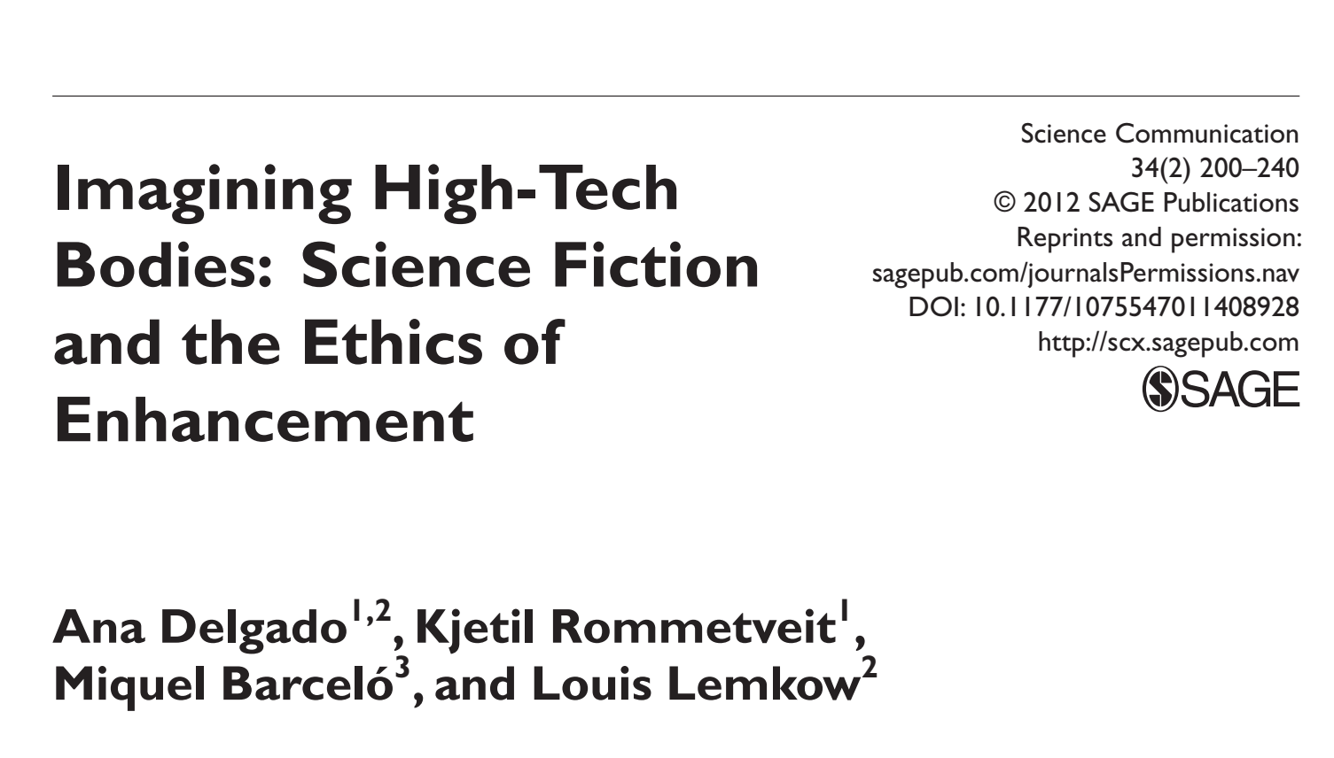

Slide 17
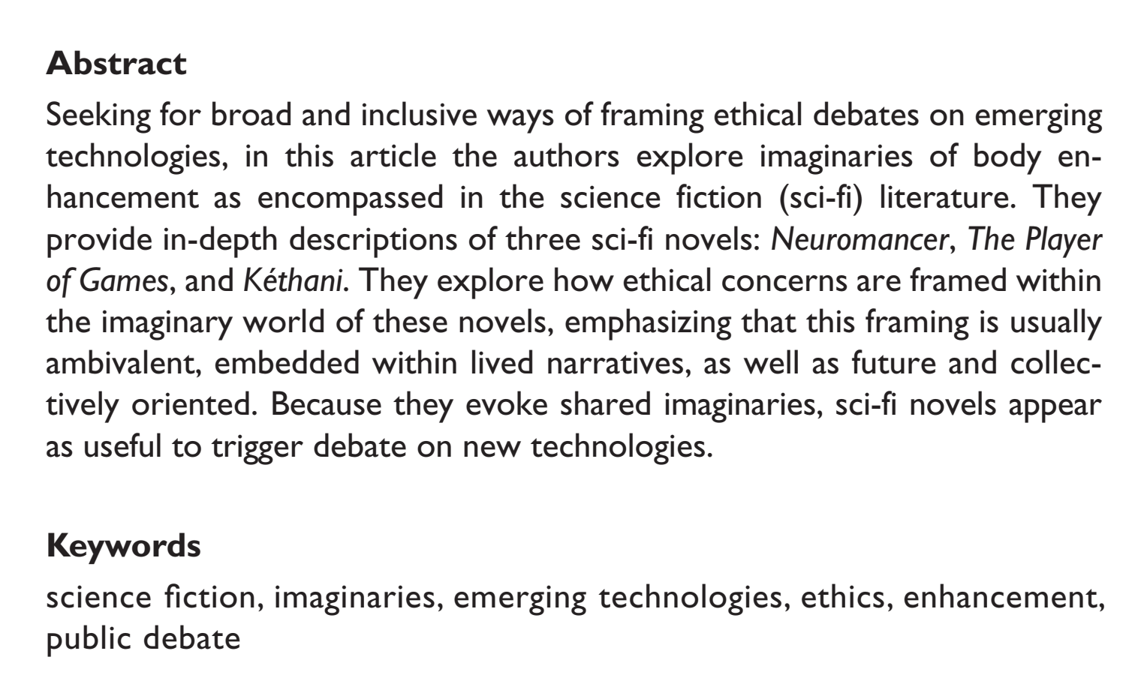

Slide 18
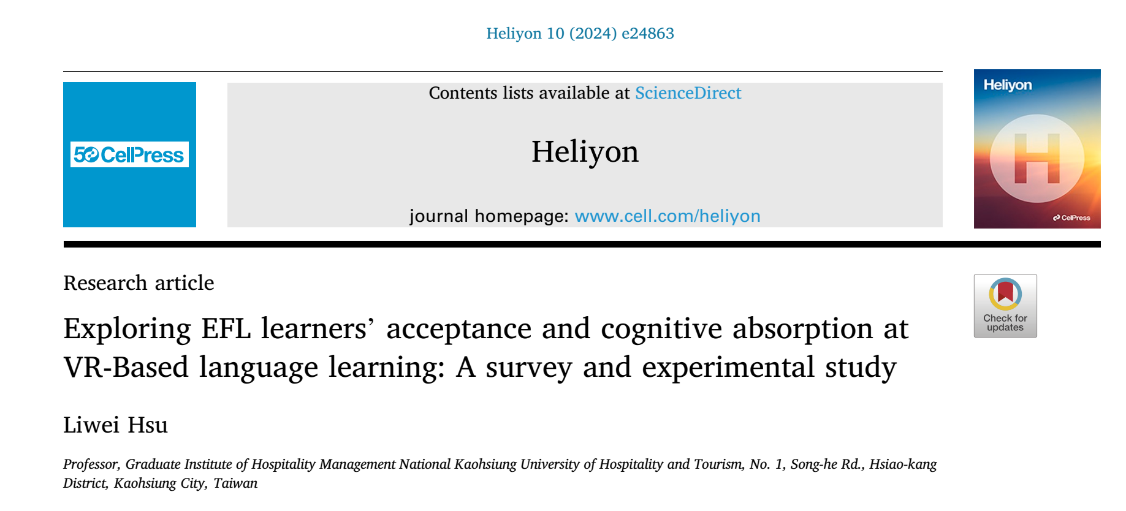
Notes:
3班10组

Slide 19

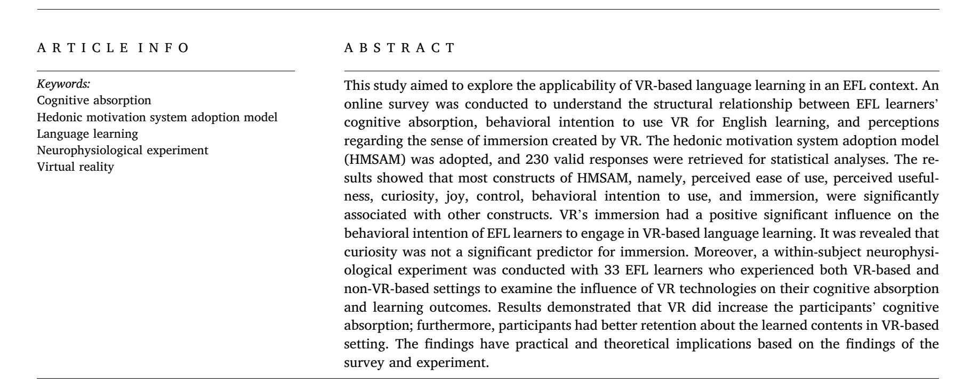
Notes:
3班10组

Slide 20
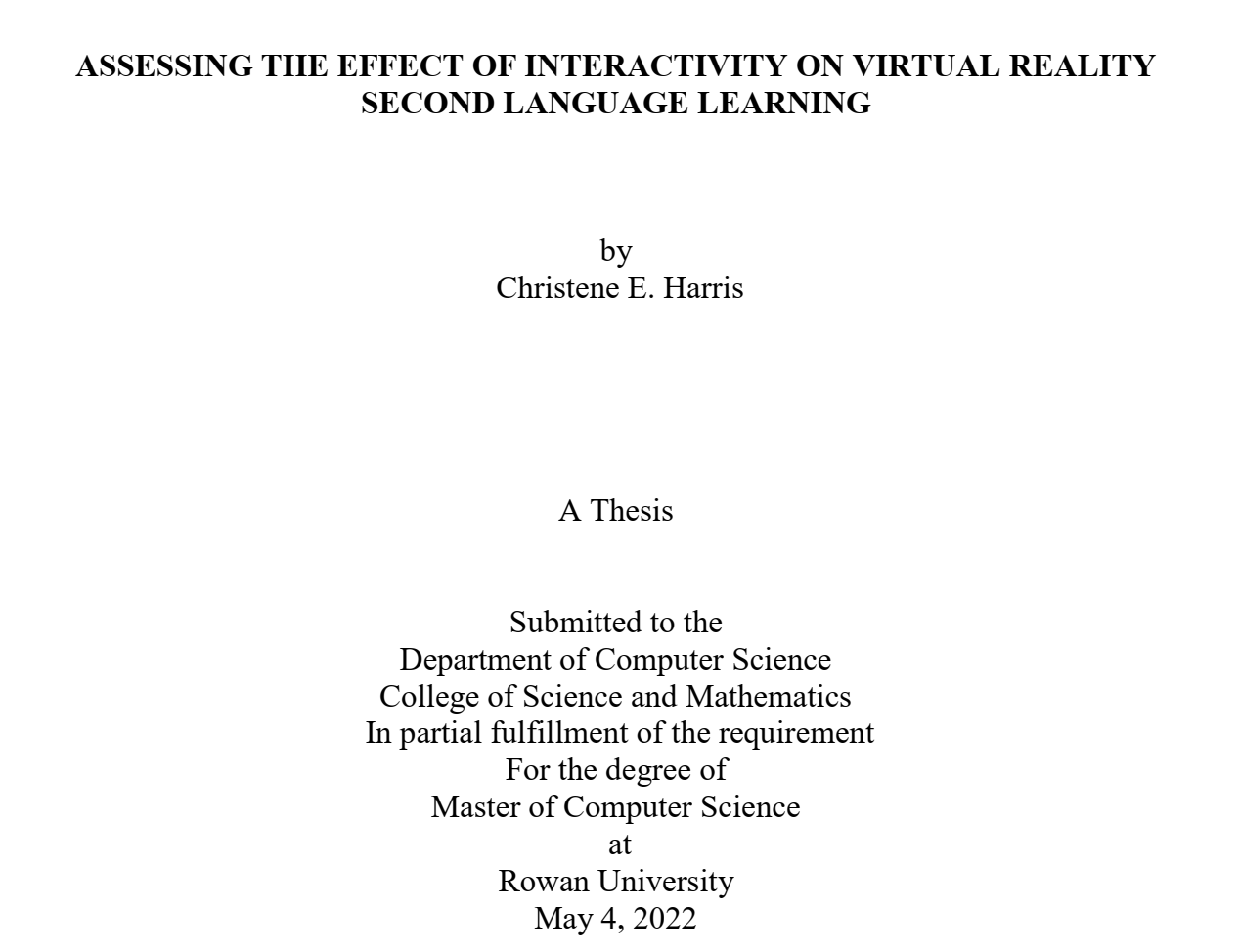

Slide 21
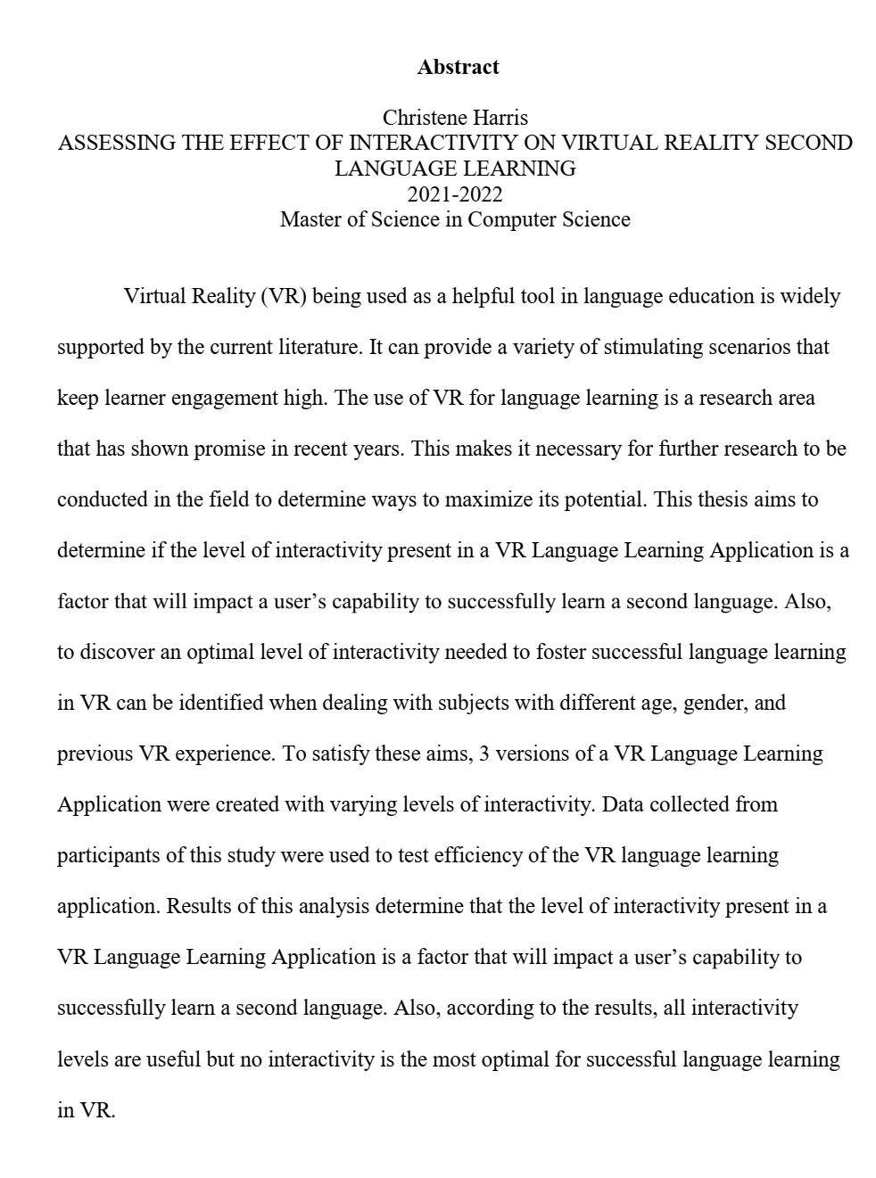

Slide 22
Section A
IMRC Format
5. Have a quick glance at the longer abstract (266 words), and identify the four sections, marking I, M, R, and C in square brackets [ ] after each section.

Slide 23
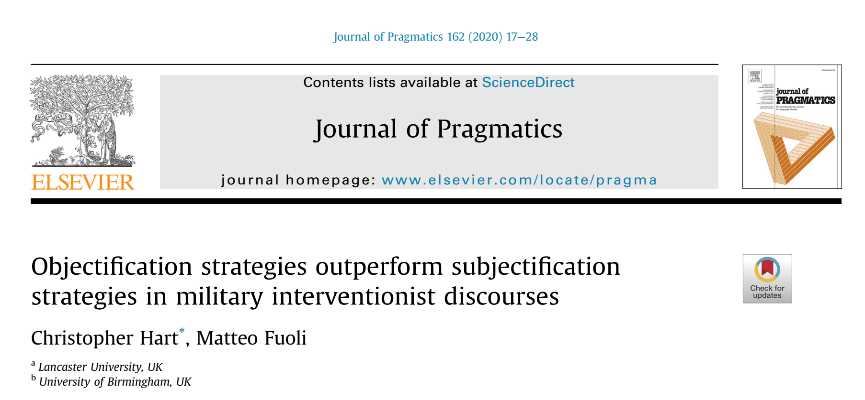

Slide 24
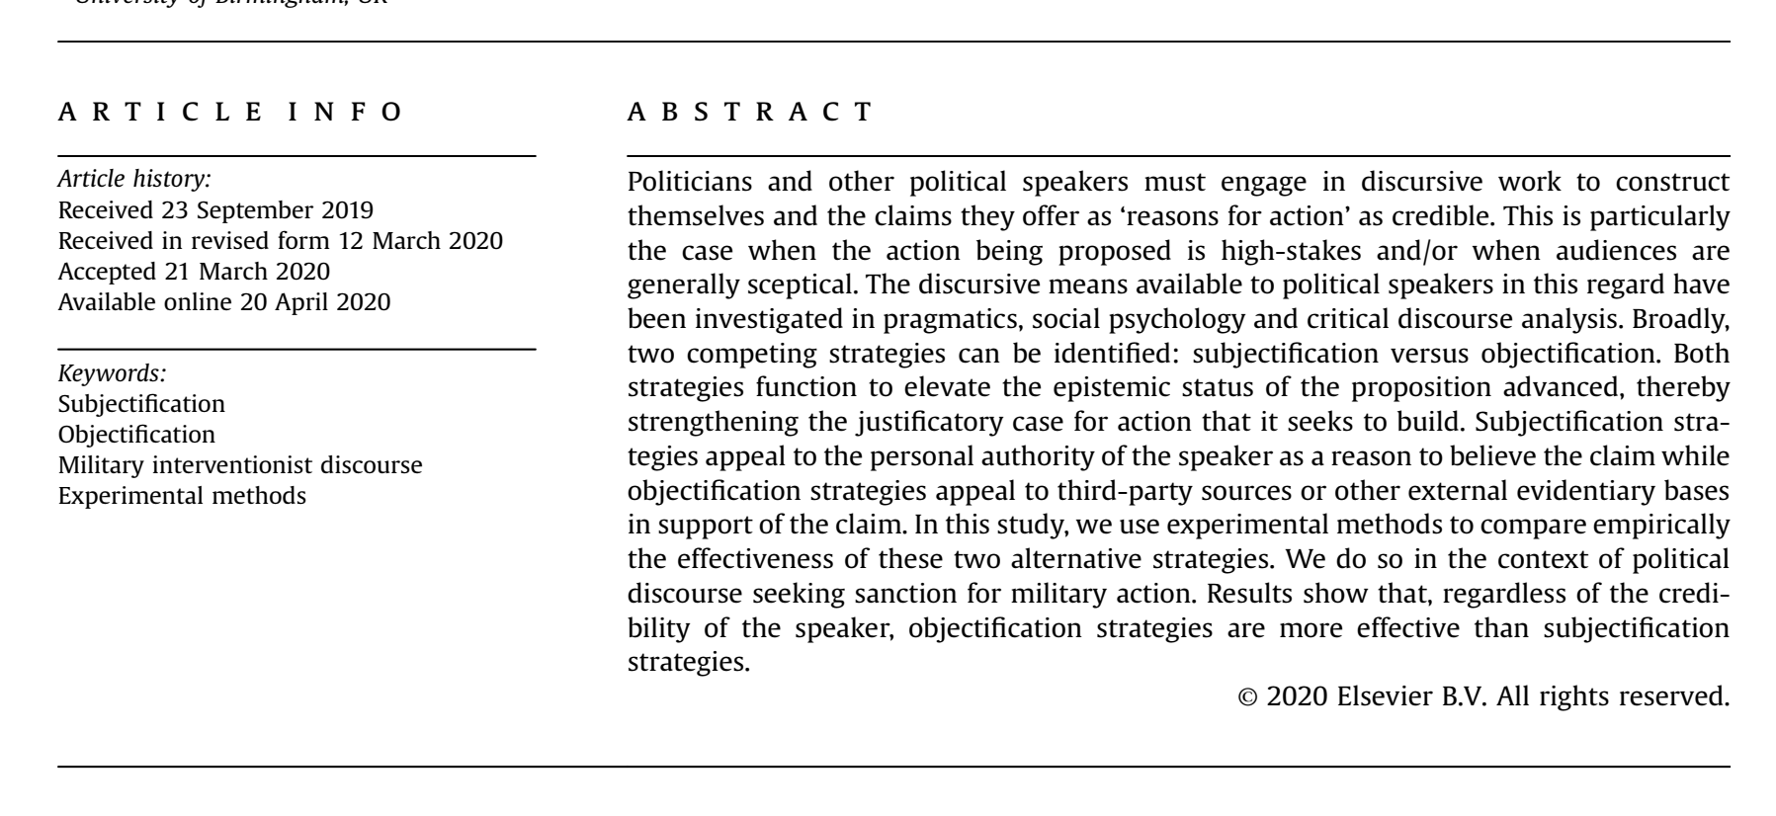

Slide 25
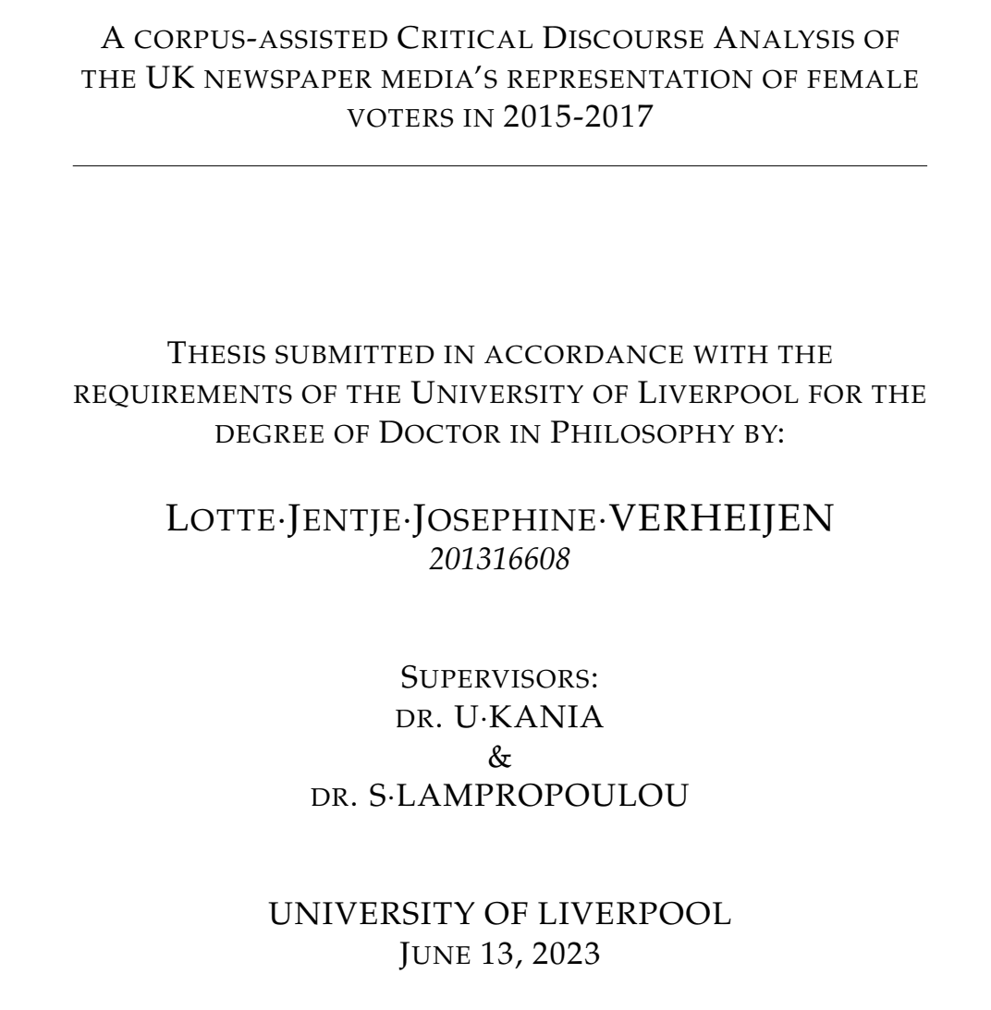

Slide 26
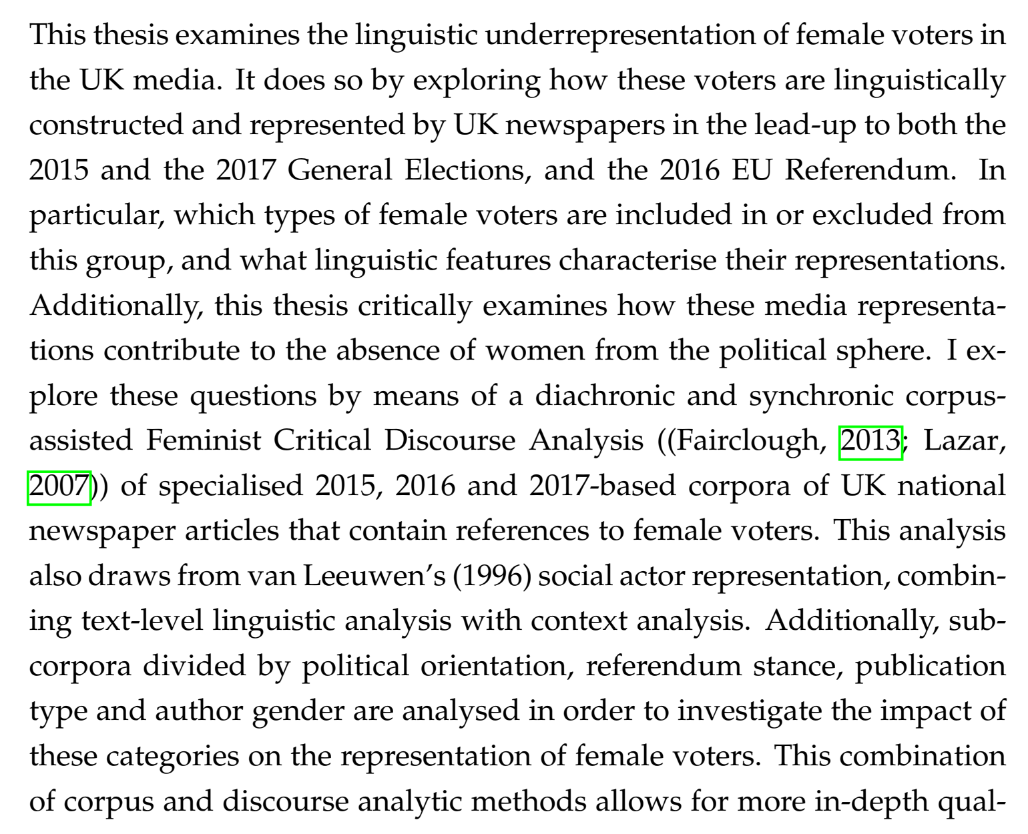

Slide 27
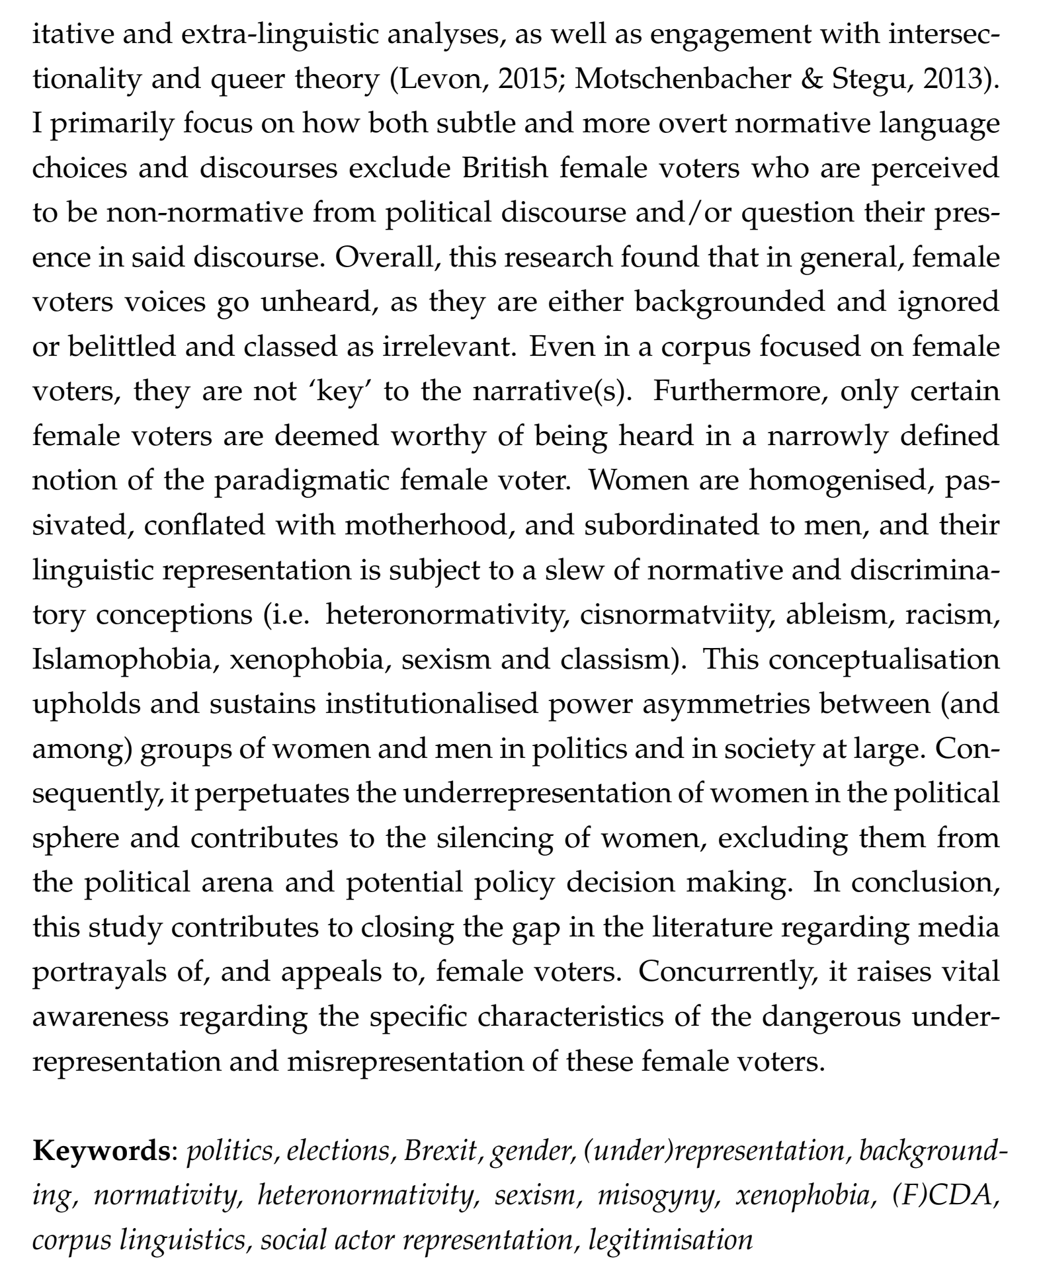

Slide 28
Abstract
Questions:
Move # | Typical elements | Implied questions
Move 1 | Background/introduction/ situation (B) | What do we know about the topic? Why is the topic important?
Move 2 | Present research/purpose (P) | What is the study about?
Move 3 | Methods/materials/subjects/ procedures/sites (M) | How (and where) was it done?
Move 4 | Results/findings (R) | What was discovered?
Move 5 | Conclusion/discussion/ implications/recommendations (C) | What do the findings mean?
点击添加文本
点击添加文本
点击添加文本
点击添加文本

Slide 29
Section A
IMRC Format
7. Identify the sections in the abstracts in your own papers and fill in the following table (the 1st one from Ex 7 is done for you). Then share yours with your partner’s and answer the question: Do all the abstracts follow the IMRC format? (SN=sentence Number、code）
组号 | 学生姓名 | 学生学号 | 文章题目 | Introdution | Aim | Materials & Methods | Results | Conclusion
xx班xx组
xx班xx组
xx班xx组

Slide 30

Section B Linguistic Features
Have a glance at the abstract and point out the striking IMRC format. Then read the abstract and observe the underlined expressions and shaded verbs. What points in content and language can you summarize?
IMRC format
Information (contents)
Grammar (language)

Slide 31
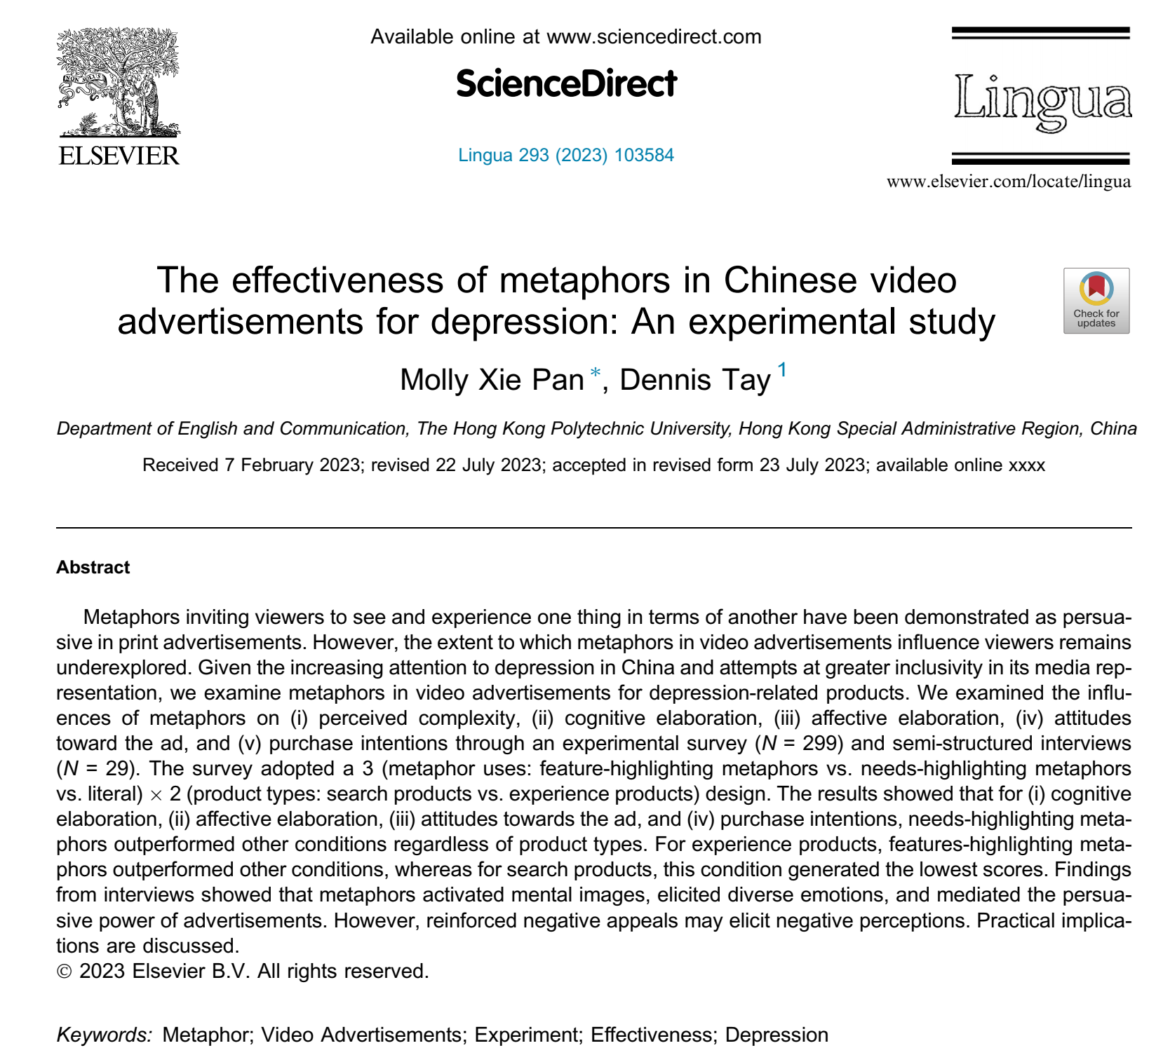

Slide 32
Section B Linguistic Features
Help seeking behavior of Chinese patients with aphasia admitted to a psychiatric hospital
Abstract
Purpose To investigate the help-seeking behaviors and related factors of Chinese psychiatric inpatients with aphasia.
Methods Two hundred and two patients with aphasia were enrolled in this study. A locally developed, semi-structured questionnaire was used to collect data, including data on illness and help-seeking histories from patients, informants, and medical records.

Slide 33
Section B Linguistic Features
Results Among the 202 inpatients, 120 patients (59.4%) had sought help from at least one type of non-psychiatric facility (NPF), and 82 patients (40.6%) went to a psychiatric hospital directly. Among the NPFs they contacted, 66 patients (32.7%) tried traditional Chinese medicine (TCM) from licensed practitioners (including acupuncturists), 64 (31.7%) chose general hospitals (including 9 who went to emergency departments), and 52 (25.7%) sought help from Qigong (breathing exercise) masters or other folk healing methods. The reasons for seeking treatment from NPFs varied; the most common ones included feeling shameful or stigmatized about going to psychiatric hospitals, inaccessibility to or unavailability of psychiatric hospitals, and fear of being incarcerated or receiving electric shock treatment.
Conclusion A substantial proportion of psychiatric inpatients in China seek help from non-psychiatric facilities and/or folk healing methods. Feeling shameful or stigmatized, inaccessibility to and/or unavailability of psychiatric services are among the most common barriers to seeking psychiatric treatment. Patients who sought psychiatric help directly are likely to be female, with a chronic onset of illness, a mixed syndrome of positive and negative symptoms, or a better economic status.

Slide 34
Section B Linguistic Features
3. Classify the verbs in each sentence of the above abstract. The first one is done for you. Then study their usages in scientific context referring to the list below, and try to understand the extra tenses.
present:
past active:
past passive:
past perfect:
infinitive:
seek / are / sought / are
went / contacted / tried / chose / went / sought / varied / included
were enrolled / was used
had sought
to investigate

Slide 35
Section B Linguistic Features
Present tense ( 现在时 ): Something happens at present time or is generally true.
Present perfect tense ( 现在完成时 ): Something has finished or has been done in the past which has effects now.
Present modal ( 现在时的情态 ): Something is possible at different degrees.
Past tense ( 过去时 ): Something occurred or was done in the past.
Present modals ( 现在时的情态 ) Some points are presented to be certain to some degree in a certain circumstance.
Past modal ( 过去时的情态 ): Some points are tentative at the moment.
Future ( 将来时 ): Predictions or actions which will take place in the future.
Infinitive ( 动词不定式 ): Research purpose is indicated.

Slide 36
Section B Linguistic Features
5. There are diversities of tense usages although scientific papers usually follow the rules that we have discussed. Read the abstracts of your own papers and fill in the table with the tenses used in each section. To simplify the discussion, you may use a, b, c, d, e, f, g and h, or names of other new tenses to indicate the tenses as used in Ex. 3.
Appendix | I | M | R | C
1
2
3

Slide 37
Introduction
Current situation or general situation about the research (literature review) (present)
what has been done in the field relevant to the target research (present/present perfect)
general situation that will cause/allow something to happen (present / future modal)
the problems in the field which remain to be solved (present)
Hypothesis for the target research which was not verified (subjunctive mood)

Slide 38
Material & Methods
General method of your research.
Research is traditionally discussed (past)
What occurred in past experiments and data analysis (past)

Slide 39
Results
The results regarded as general regulations (past)
What were found in the past experiment and data analysis (past)

Slide 40
Discussion and Conclusion
Laws, principles, or theories based on research results (present)
Conclusions of the current effect produced by past event (present/past)
Fairly certain conclusion (present)
Conclusion which is only regarded as one in a past event (past)
Conclusion with less degree of certainty (past/present)
Certain prediction (future / modal)

Slide 41
Section B Linguistic Features
1. Read the first extract and analyze the discourse to see how the background knowledge is explained and the research purpose is introduced. Explain why a specific tense is used in a particular sentence.

Slide 42
Section B Linguistic Features
1) Students in introductory courses generally respond favorably to novel approaches to learning. 2) To this end, I developed and used three crossword puzzles in spring and fall 2009 semesters in Introductory Soil Science Laboratory at Colorado State University. 3) The first hypothesis was that crossword puzzles would improve introductory soil science students’ interest in lab assignments...
S1 general background: students’ favorable way of learning elementary course (general fact. Present tense is used)
S2 general material and methods of the research: crossword puzzles were developed and used in a particular course (past event. Past tense is used)
S3 1st hypothesis: function of crossword puzzles: improve students’ interest in lab (tentative. Modal is used)

Slide 43
Section B Linguistic Features
2. Observe the underlined expressions in abstracts and describe their functions. Then list a few different ways you could express the same meaning:

Slide 44
1. The study examines how different framing strategies can influence readers' affective responses and perceptions of aggression and blame assignment.
2. This study investigates the role of vagueness and precision in corporate communication and their effects on perceived credibility and trustworthiness.
3. This study compares the construction of research questions by native English-speaking authors and Chinese EFL (English as a Foreign Language) scholars.
4. This paper presents a corpus-based analysis of the lexical item 'war' within the LAR (Lexical Approach to Reading) framework.
5. This study explores the impact of nativeness perceptions and speaker voice on the evaluation of non-native English speakers in different EFL (English as a Foreign Language) contexts.
6. This study analyzes the use of dynamic metaphors in governmental discourse related to trade negotiations between Trump and Xi.
7. This longitudinal study tracks the development of logical metaphor usage in argumentative writing by EFL learners.
8. This paper presents a framework to detect emotions on translated text data in four different languages.

Slide 45
1. Using an experimental design, we tested the impact of these strategies on participants' credibility assessments.
2. Through an experimental approach, we analyzed how varying degrees of linguistic precision in corporate messages influence stakeholder perceptions.
3. Participants engaged in a lexical decision task involving both types of characters.
4. Using an experimental design, we evaluated the effectiveness of metaphorical versus non-metaphorical advertisements in terms of emotional engagement and message retention.
5. Using a mixed-methods approach, we analyzed the content and frequency of posts related to personal achievements and setbacks.
6. By comparing the effects of peer and teacher feedback, we assess improvements in students' writing skills.
7. Through corpus analysis, we examine how the aspectual choice affects the perceived intensity of the verb.
8. Using discourse analysis, we identify and interpret the metaphors employed by both leaders to frame their positions and strategies.
9. Computational intelligence (CI) techniques are applied to extract features, dimensionality reduction, and classification of data into five basic classes of emotions.

Slide 46
Section B Linguistic Features
4. Distinguish the underlined expressions below in abstracts; which discourse markers indicate that “I am going to tell you the results in the following part”or report the results directly without an “indicator/ marker”? Then discuss: What tense is used and why?

Slide 47
1. Results indicate that frames emphasizing violent aspects of protests lead to higher perceived aggression and increased blame attribution to protesters, while frames highlighting peaceful protest activities evoke more sympathetic responses and reduced blame.
2. The results demonstrate that objectification strategies, which employ factual and statistical evidence, are more effective than subjectification strategies, which rely on personal testimony and opinion.
3. Findings reveal that precise language enhances credibility and trust, while vague language detracts from these perceptions.
4. Results show that L1 English authors tend to use more complex and nuanced research questions, while Chinese EFL scholars often employ more straightforward and less elaborate questions.
5. The results indicate that both perceived nativeness and speaker voice significantly affect evaluations, with native-like accents and confident voice qualities leading to more favorable assessments.
6. The findings show a gradual increase in the sophistication and frequency of logical metaphors, suggesting that targeted instruction can enhance metaphorical competence in argumentative writing.

Slide 48
Section B Linguistic Features
5. What are the discourse markers to indicate “discussion” in abstracts? Underline them in the following sentences, paying attention to the tenses. Then try to summarize their structure.

Slide 49
1. The study contributes to the literature on persuasion and credibility in corporate communication by providing empirical evidence for the superiority of objectification strategies in CSR discourse.
3. The research highlights the importance of clear and specific communication in corporate contexts to foster trust and credibility among stakeholders.
3. The findings suggest that targeted training in research question formulation could benefit Chinese EFL scholars, enhancing their academic writing skills and research outputs.
4. The findings have pedagogical implications for teaching vocabulary and reading comprehension in contexts involving historical and contemporary discussions of war.
5. The study provides insights into the development of advanced writing skills in EFL contexts and offers practical implications for teaching metaphor usage.
6. Results suggest that priming can be further examined as an intervention procedure for grammar, indicating the potential efficacy of grammar intervention using a syntactic priming task.

Slide 50
Section B Linguistic Features
6. Discuss with your partner: Should you write your abstract before or after you finish the paper? What is your strategy for deciding Keywords?
an abstract is always written after the paper is finished so that the main points are easily identified and ranked according to their importance. this is also true for keywords selection

Slide 51
Summary
Section A
An abstract plays a foregoing role to introduce the complete picture of the paper. A good abstract always consists of key points of all the IMRC. Research aim should be reported. An infinitive phrase is usually enough for it and regular method is written as its main clause. Or alternatively, a sentence or sentences may 16 17 Unit 3 Abstract 63 be used. Sometimes necessary background knowledge or theory is indispensable. A special approach created by the writer has to be introduced briefly. Major tendencies and significant individual or grouped results are emphasized. The discussion with conclusion based on the data is another focal point of the abstract. An abstract should be written after its complete paper is finished and the most important points should be briefly presented. It is not recommended to only report RD, although the capacity of an abstract is limited.

Slide 52
Summary
Section B
Tenses are complicated in sections and also different in journals. Following the grammatical rules of tenses, they generally indicate particular academic meanings:
Present tense: Something happens at present time or is generally true.
Present perfect tense: Something has finished or has been done in the past which has effects now.
Present modal: Something is possible at a different degree.
Past tense: Something occurred or was done in the past.
Present modals: Some points are presented to be certain to some degree in a certain circumstance.
Past modal: Some points are tentative at the moment.
Future: Predictions or actions which will take place in the future.

Slide 53
Summary
Section B
Although tenses are used in a diversified way in different journals, they usually follow the regulation that past indicates Materials and Methods as well as Results because a research process occurred in the past. Present and present perfect are used in Introduction and Discussion and Conclusion since previous research work is regarded valuable or available and new findings are generally true.
Different from Chinese, English is a language which shows particular functions with obviously distinctive discourse markers and habitual expressions. Therefore, we have to be familiar with them so as to accurately and efficiently use them.
It is not a good idea to put all pieces of information in one very long sentence. Although long and complex sentences are a feature of formal style, excessively long ones are awkward in style. We have to follow grammatical rules to write appropriate and regular simple, compound and complex sentences.

Slide 54

Section C Formal Language
Formal style is shown in all levels of language as we have discussed. Try to distinguish the formal expressions from the less formal or informal ones and then match the rules.
Rule 1: Third person pronoun is formal while first person can be applied but frequent use will produce boring or even awful effect although in some discipline it is always used. The second person pronoun is forbidden.
Rule 2: When all the items are listed, it is unnecessary to use “etc”, but it is used to show that only a small proportion in a list is mentioned and others are omitted.
Rule 3: An adverb is put closely with predicate verb or infinitive verb to express the logical meaning more accurately.
Rule 4: Verb abbreviation is not allowed.

Slide 55

Section D Exercises
1. Write an abstract of 100-150 words and decide the key words for the simplified paper below.
Title:
A Contrastive Analysis on Abstracts of Research Papers in Chinese and English Journals

Slide 56
Section D Exercises
Introduction
English abstracts are vitally useful for scholars in their academic endeavors. To help Chinese graduate students in their English academic writing courses, it is necessary to understand the current linguistic differences which often occur in abstracts written by native English scientists and Chinese scientists.
Abstracts are generally used in four occasions: 1) journal articles/theses; 2) academic conferences/workshops; 3) dissertations; 4) collections of theses. The abstracts analyzed in this study focused on the first category. The term “abstract” is defined as “an abbreviated, accurate representation of the contents of a document, preferably prepared by its authors for publication with it” (ANSI). It is stated that of titles and abstracts that, for “those who read the title, only some will read the abstract, and those who read the abstract only some will read the article itself” (Snows, 2004:179). For this reason, Deidre (2010) describes abstracts in the following manner: “an abstract should be viewed as a mini-version of the paper. An abstract should provide a brief summary of each of the main sections of the paper.” Therefore, a well-prepared abstract enables us to identify basic linguistic features of an academic paper.
Green (2011) asserts that the most common structure for an abstract is a fourpart arrangement consisting of Problem-Method-Results-Conclusion although Snows (2004), Sanitoes (2006) and Teapett (2009) have slightly changed or expanded upon these categories.

Slide 57
Section D Exercises
2. Methods
2.1 Sample Collection
Sample abstracts were first randomly selected from 20 different fields in theoretical and applied natural sciences, social sciences, medical science, and economy. For each field two English abstracts by native speakers, (hereafter referred to as authentic English abstracts Ea*1), and two of similar theme or topic translated from Chinese to English were chosen (Ta’s *2), along with the original Chinese abstracts (Ca*3 ). In total, 80 authentic English abstracts were selected, providing sufficient data for a contrastive analysis.
2.2 Data Collection
Each abstract was divided into four sections following Bhatia’s (1993) model. A different color was used to distinguish the different sections: red for introductions, black for methods, green for results, and blue for conclusions.
The linguistic features which characterize the nature of each section were identified. For the comparison between Ta and Ea, the verb tense, passive voice, modal verbs, first person pronoun and length of section were discussed. For the comparison between Ca and Ta, the translation of scientific terms, numeric figures and units, and the syntactic divisions were examined.

Slide 58
Section D Exercises
2.3 Data Processing
SPSS (Statistical Package for the Social Sciences) was applied when conducting the statistical analysis. Frequencies were calculated and used to generate bar charts and pie charts (omitted in this simplified paper). The Chisquare test was sometimes used to reinforce the research results.

Slide 59
Section D Exercises
3. Contrastive Analysis between Ta and Ea
3.1 Frequency of Sections
The total number of moves in each section of the Ea’s and Ta’s were calculated respectively, and a contrastive analysis was made between the 40 Ta’s and 40 Ea’s.
Table 1 Moves of each section in Ta and Ea
The data show that Chinese writers tend to express more in the introduction section than their own M, R, and C moves and, more than those in the introduction written by their foreign colleagues. The fact that some journals in China do not have standardized requirements on the abstracts may cause neglected or missed out sections by Chinese authors. The data also show that some points should be expressed in the conclusion section instead of in the introduction section.
 | Introduction | Method | Result | Conclusion | Total
Ta | 40 | 6 | 7 | 14 | 67
Ea | 37 | 19 | 13 | 33 | 102
Total | 77 | 25 | 20 | 46 | 169

Slide 60
Section D Exercises
3.2 Linguistic Features
3.2.1 Tenses
Seven verb tenses were identified throughout all of the abstracts. The distribution of verb tenses (including model verbs) in the abstracts of Ta and Ea are listed in the following two tables:

Slide 61
Section D Exercises
Table 2 Distribution of verb tenses in abstracts of Ta
 | Introduction | Method | Result | Conclusion | Total
Present simple | 67(56.8%) | 2(18.2%) | 7(30.4%) | 25(62.5%) | 101
Past | 43(36.4%) | 9(81.8%) | 14(60.9%) | 14(35.0%) | 81
Present perfect | 4(3.4%) |  | 2(8.7%) | 1(2.5%) | 7
Simple future | 1(0.8%) |  |  |  | 1
Present continuous | 2(1.7%) |  |  |  | 2
Present perfect continuous | 1(0.8%) |  |  |  | 1

Slide 62
Section D Exercises
Table 3 Distribution of verb tenses in abstracts of Ea
 | Introduction | Method | Result | Conclusion | Total
Simple present | 81(73.6%) | 6(12.5%) | 10(34.5%) | 50(64.1%) | 147
Past | 12(10.9%) | 39(81.3%) | 19(65.5%) | 18(23.1%) | 88
Present perfect | 16(14.5%) | 3(6.3%) |  | 5(6.4%) | 24
Simple future | 1(0.9%) |  |  | 3(3.8%) | 4
Present continuous
Present perfect continuous |  |  |  | 1(1.3%) | 1
Past perfect |  |  |  | 1(1.3%) | 1

Slide 63
Section D Exercises
It is obvious to see that prominently used tenses in both are similar for each section because the content and function in each section is well-defined. However, there is a large proportional difference between present simple and past in the sections, eg. Introduction—67: 43 in Ta but 81: 12 in Ea. The difference definitely indicates that Chinese writers are not thoroughly aware of the subtle meaning of tenses and the functions they play although the writers understand some grammatical rules. The differences in using other tenses further confirm the point. The fact that their mother tongue, Chinese, is meaning-centered rather than formcentered, is certainly a factor.

Slide 64
Section D Exercises
3.2.2 Passive Voice
The frequency of passive verbs was also examined respectively.
Table 4 Frequency of passive verbs
 | Introduction | Method | Result | Conclusion | Total
Ta | 39 | 11 | 13 | 13 | 76
Ea | 25 | 34 | 13 | 31 | 103
Total | 64 | 45 | 26 | 44 | 179

Slide 65
Section D Exercises
Table 4 indicates that considerably more passive verbs were used in Ea than in Ta. One reason is negative transfer, which behavioral psychologists define as “the process of automatic, uncontrolled, and subconscious use of past learned behavior in the attempt to produce new responses”. This could be because Chinese writers Unit 3 Abstract 71 have less experience using the passive voice in Chinese when writing method sections. Another possible reason may be the different concepts about the doer of an event.

Slide 66
Section D Exercises
4. Conclusion
Carefully prepared course material with sufficiently concrete data is necessary for graduate students to understand the differences between the two languages in academic writing. It will also be helpful for them to have a deeper insight into the subtle meaning that the English texts reveal. The possible reasons explaining the results remain to be further studied specifically so as to be convincing.

Slide 67
Suggested abstract:
To improve the writing quality in a graduate English writing course, abstract sections and linguistic features were studied by double contrastive analyses between translated English abstracts (Ta) and native English ones (Ea) and between Ta and original Chinese ones(Ca). The results show differences and similarities in moves, tenses and voices between Ta and Ca, indicating that it is necessary for Chinese writers to have a deeper insight into the nuances of English writing and to understand the structural differences between the two styles. Therefore, teaching materials to meet this requirement should be developed in order to improve the English writing skills for the target learners.
Key words: Sections, linguistic features, double contrastive analyses

Slide 68
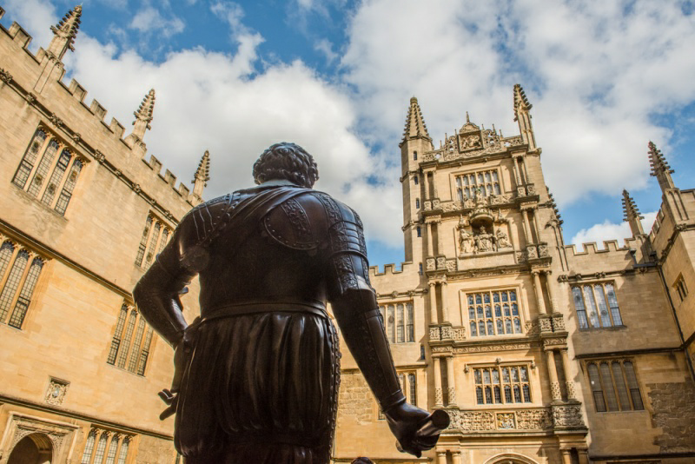
Thank You

